Slide 1
DIMENSIONS OF DIGITAL WELLNESS

Slide 2
OUTLINE OF PRESENTATION
1. Concept of Well Being
2. Dimensions of Wellness
3. Concept of Digital Well Being
4. Negative consequences of excessive use of digital devices on various dimensions of well being

Slide 3
Well-Being
A state characterized by good health, happiness and satisfaction.
Ultimately goal is to foster a good life, to live in accordance with socially negotiated and personally held values.
Presence of positive emotions (contentment) and absence of negative emotions, sense of fulfilment, positive functioning

Slide 4
WHO: individual realizes their potential, can cope up with normal stressors of life, can work productively and fruitfully, and is able to contribute to their community.
Active process of becoming aware of, making choices towards a healthy and fulfilling life.
Our wellness is affected by all that we do, what we think and what we believe

Slide 5
Proactive approach that promotes an optimum manner of physical and social functioning and leads to emotional well-being.
Mental Health
Cope better, manage emotions, seek help, work productively, sense of well-being
Physical Health
Social Health
Being connected with others, satisfying relations, good functioning in social groups
Good nutrition, absence of illness
Notes:
Three pillars of well being

Slide 6
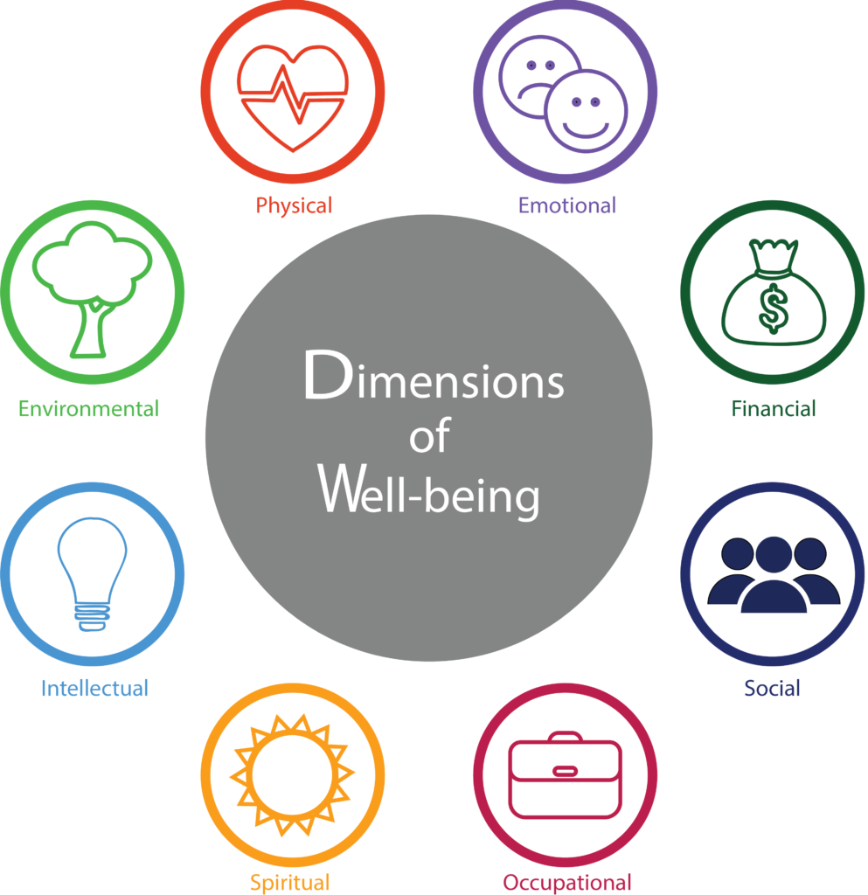

Slide 7
Dimensions of psychological well being
There are six dimensions of psychological well being:
Self-Acceptance: Having a positive opinion about oneself
Positive Relationship with other: Includes pleasure and satisfaction that comes from close contact with people.
Autonomy: Refers to persons ability to pursue personal convictions and beliefs

Slide 8
Environmental mastery: This ability requires that the individual masters the environmental challenges around himself.
Purpose: Ability to find purpose and meaning in life
Personal Growth: Ability to realize one potential and work towards it.

Slide 9
So how does this apply to digital spaces…..
As digital media has become increasingly intertwined with our every day activities, so has the potential impact of its usage on our life.
Nothing inherently beneficial or harmful about digital media per se, but they play an important role in peoples well-being.

Slide 10
Constant abundance of digital media around us. Smartphones, videogames, social media, computer- all have become an integral parts of our life. Increasingly device dependant world.
With the pandemic, there has been an increase in use of technology. And with excessive use of digital technology, there has been an increased toll on our health and well-being.

Slide 11
There is now an unconscious and effortless reach out for gadgets, even when not mandatory.
The devices are also devised in such a manner that it has the ability to lure an average person to use to tap and swipe their phones hundreds of times in a day.
The impact of digital technology usage and well-being to be harmful is limited only to small proportion of individuals.

Slide 12
Constant connection has led to social pressure to be constantly in touch with peers, safety issues with excessive usage, and overall decrease in mood and well-being.
Digital wellbeing is an upcoming intervention to ensure ones mental and physical health is an environment with digital abundance.

Slide 13
What is Digital Well-Being?
The concept of digital well being refers to the optimal state of health and well-being that one can achieve while using technology.
It empowers us to take advantage of the benefits of technology while avoiding associated harms.
It is an act of practising healthy digital habits.
How to do we do that?
Taking a mindful and intentional approach to using technology that supports our thriving and optimal well-being.

Slide 14
Essentially it means to live holistically healthy lives considering all activities that involve use of digital technologies.
Technology should improve our lives and not distract from it.
Digital well being enhances the use of technology itself to combat increased screentime by using restrain and it promotes wellness by enabling productive and healthy lifestyles.
Studies have shown that increased use of digital devices are associated with decline in performance rates, has effects on sleep patter, reduction in workplace achievements and thereby hindering from achieving ones potential

Slide 15
In order to thrive alongside technology, we have to enhance our skills.
Skills in the key areas that our digital behaviour relate to, and that includes our mental and physical health, our relationships, productivity, communication, environment.
These are the various skills that students need to learn in order to navigate and thrive in the online world today.
Skills--------need to learn...

Slide 16
Essentially there is a need to prioritize control over use of digital devices & focus on aligning their use with one’s long standing goals.
Balanced use of digital technology generally does not harm anyone.
Hence we now need to understand the negative consequences of excessive use of digital devices on various aspects of one’s life.

Slide 18
Why it is a concern?
We are spending almost 70 minutes a day on OTT platforms, 40 min average session-----increase during multiple use
We are using digital devices for work, learning, entertainment and all forms of communication.
There has been an 47 % increase in data traffic since 2019, and 96% of this was constituted by 4G.
Data usage has grown to up to 11.7 GB/month-----there has along side a decrease in cost of 1GB data (Rs 7/-)
Excessive use of pornographic content among adolescents
Rising mental health issues among children and adolescents.
Decreased life satisfaction with increased use and resulting stress.

Slide 19
Negative consequences of excessive use of digital media
Negative consequences of excessive use of digital media can spill over to several areas of one’s life:
Physical Health
Emotional Health
Psychological well being
Interpersonal Relationships
Often dysfunction in one area will lead to problems in other areas as well.

Slide 20
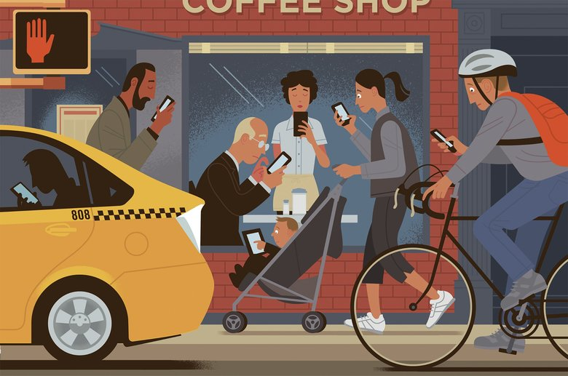


Slide 21
New terms have been developed over years like - “Binge watching”, “Zero Inbox Syndrome” (tendency to read and respond to every message-------- even at night--------disturbed sleep------increased screentime), ‘cyber violence’ (stalking, bullying, misuse of information)
Similarly, we have the tendency to check mobile phones 60-70 times everyday------increased time spent on phone-----2/3 hours of productivity goes away everyday.
Increased time spent watching devices passively (actively during gaming)------- increased risk for obesity-----------procrastination on several important tasks.
Increased sense of connectivity and safety associated with use of smart devices------even children given phones for safety reasons-------introduced to multiple information's online at a very young age

Slide 22
Impact on Child’s Academic performance
Excessive use of digital devices is most commonly associated with poor grades-----------------poor performance in school
Poor mental health of the students-------interferes with learning new information
Some times using technology for academic purposes might lead to increased distraction--------- difficulty in multitasking

Slide 23
Difficulty in learning new technology and learn the actual task-----more efforts and time--------- may feel anxious and overwhelmed (more time is spent in learning how to use technology than the material itself).
Information overload-----feel that every new material that has been posted needs to be reviewed

Slide 24
Misinformation-------early exposure to pornographic materials online------may become victims to cyberbullying
Digital flashing

Slide 25
Impact on Mental Well being
Risk of developing anxiety & depression
Children with vulnerability-----increased risk for developing mental illness including addiction due to excessive use of digital devices
Increased feelings of loneliness and isolation------decreased interactions

Slide 26
Increased difficulty in attention & concentration
Difficulty in managing & regulating ones emotions-----irritability, anger
Need to have digital devices in immediate vicinity, even at night, anxiety of having lost their phones------nomophobia
May experience distraction from phones while getting to know other people

Slide 27
Some people may experience stress from constant emails and digital message notifications during work
In young children: low creativity, delays in language development, delays in social and emotional development

Slide 28
Impact on Social well-being
Interrupts people from forming genuine connections with the world
Increasing their disconnectedness, lack of real human connections
Low self-esteem----spend more time comparing oneself with others in online platforms, not with real family and friends----- even to celebrities
Can lead to negative self talk and body image issues------further risk for mental health issues
Notes:
Social bonding, socialization, no verbal communication, child does not come out of room

Slide 29
Many people rely on technology to build and sustain relationships but at times over dependence on digital technology leaves people feeling qualitatively empty and alone.
Poor family and couple relationships-----less quality time, more reliance on digital devices to connect
Poor social skills

Slide 30
Anxiety and stress when other person does not respond--------preoccupation-----------low mood (they don’t care about me)
Need for approval from online followers---------filters on social platforms----------low self-esteem

Slide 31
Impact on Physical Well Being
Decreased physical activity----------sedentary lifestyle
Increases risk of various diseases- DM, obesity, heart diseases, higher BMI
Radiation from these devices have been of concern as brain tumour risk factor for children
Eye strain (screentime, screen glare, poor sitting posture, screen brightness)

Slide 32
Sleep issues- Interferes with circadian rhythms, decrease sleep quality and duration.
Poor self care, decreased opportunities for physical movement and exercise
Carpal tunnel syndrome-------neck pain

Slide 33
Impact on Occupational Well Being
May lead to reduced work productivity-----more time with digital devices
Frequent absenteeism from work
Increased stress levels at work due to constant digital interference
Risk for burnout increases

Slide 34
To benefit from digital technologies, we need right set of skills.
Digital wellness is important because it enables us to be more engaged with others and more productive in our work.
Avoiding digital devices during work, increases attention & concentration, less risk for developing mental illness

Slide 35
Digital Competencies
1. Digital safety and security: The ability to critically identify, understand, and manage different levels and kinds of digital threats while being able one’s identity, data, and wellbeing online within a safe digital environment.
2. Digital rights and responsibilities: The ability to be accountable online, to uphold human and legal rights using technology, and critically dealing with personal information.
3. Digital communication: The ability to establish clear and effective modes of communication that would allow expression and collaboration through technologies to achieve intended goals
Notes:
Understand well beinh in digital context

Slide 36
4. Digital emotional intelligence: The ability to critically recognize, evaluate, and express one’s emotions as well as demonstrate empathy towards other people in digital interactions and environment.
5. Digital creativity: The ability to create and reimagine knowledge and technologies into reality through ICT tools and innovations.
6. Digital health and self-care: The ability to be aware of one's physical and psychological wellbeing and maintain a healthy relationship when using technology

Slide 37
7. Digital consumerism: The ability to fair, informed, and equitable choice in the online market while being protected with consumer rights.
8. Digital employment and entrepreneurship: The ability to identify and use opportunities to acquire competencies to improve professional life and contribute to the global economy.
9. Digital activism/civic participation: The ability to spur and participate in cause oriented groups and initiatives that affect meaningful changes in digital and physical environments; the ability to be protected against dis/misinformation while being informed with relevant and validated data

Slide 38
Understanding these consequences of excessive use on our mental health or wellness, we can be more mindful while using digital devices.
Digital devices can be great tools for productivity, connection even entertainment and may help enrich our lives.
Being thoughtful, intentional and mindful while using these devices will enhance our well-being not detract from it.

Slide 39
Adhering to setting self-limits and restricting use of digital devices are often tricky and cumbersome.

Slide 40
THANK YOU!!

